Slide 1

RYETUBESAT DESIGN AND TEST RESULTS
by
Space Systems Design Team 2019
Department of Aerospace Engineering
Ryerson University, Toronto, Canada
Notes:
RyeTubeSat design and test results 2019

Slide 2

Power
Nathan Paes
Macarena Soncini
Alessio Previte
Gajamukan Thiruchchelvam
Hari Thavaraj
Huraira Mansoor
Notes:
Nathan
Hi welcome to our presentation, we are the power team.
[Introduce yourselves]

Slide 3
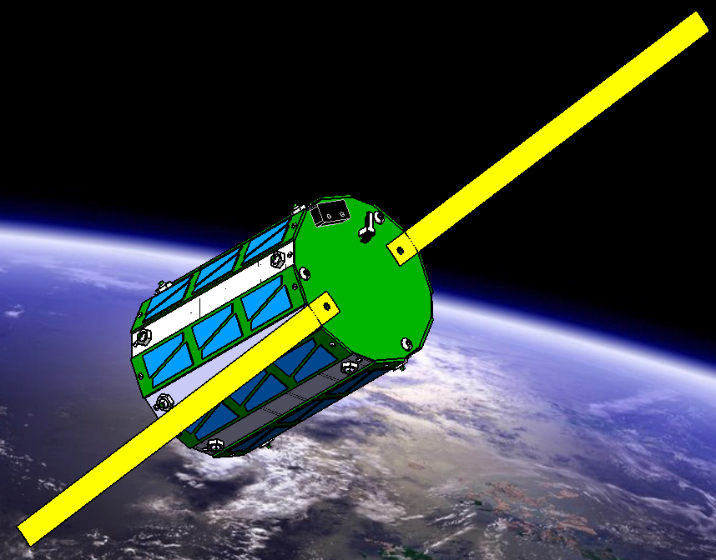
Presentation Outline
Mission and Vision
Changes Since CDR
Design
Assembly and Testing
Test Results
Remarks
Notes:
Huraira
Here is the presentation outline for today.

Slide 4

Mission and Vision
Provide power to multiple components and subsystems of the RyeTubeSat
Ensure necessary power for 3 months while in a Low Earth Orbit (310 km)
Capture solar energy so as to recharge the onboard batteries
Be able to operate during any event period
Be able to conserve power for a period of eclipse
Maintain the battery at nominal charge during direct contact with the sun
Notes:
Hari
The purpose of the power subsystem in the TubeSat is to provide power for the various components and subsystems of the TubeSat to ensure optimal operation. Various subsystems require power for auxiliary components, such as the radio, data transmitters, receivers, onboard camera, as well as any active control systems used for guidance or orientation. The general requirements for the power subsystem, in relation to the entire TubeSat, is to provide necessary power for 3 months in a Low Earth Orbit. Additionally, the power subsystem must be able to capture solar energy and recharge the onboard batteries in order to limit the amount of batteries needed for the mission and therefore reduce weight on the entire system. The power system must be able to operate during any event period, either while in eclipse or in view of the sun, meaning it should be able to conserve power for eclipse and keep the battery at nominal charge during direct contact with the sun. A more detailed and extensive list of requirements can be found in the FRR report.

Slide 5
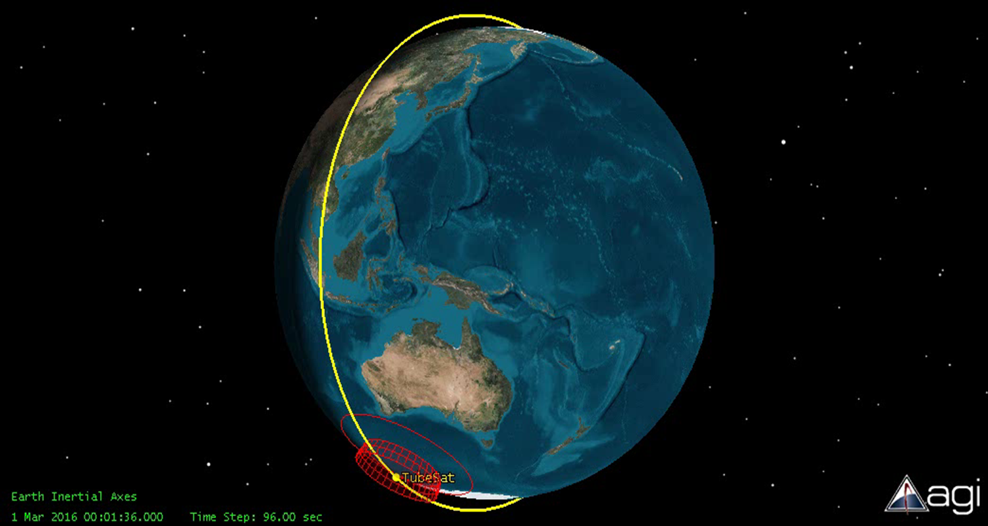
Mission and Vision
Harnessed solar energy used to charge the battery by means of the battery circuit board
Each solar panels to be arranged across the hexadecagonal exterior of the satellite to ensure that a percentage of the panels are acquiring solar energy
The solar energy is converted to electrical energy on-board and is then distributed to the battery
Notes:
Hari
The power subsystem receives solar energy which is harnessed and used to charge the battery by means of the battery circuit board. The solar panels are arranged throughout the hexadecagonal exterior of the satellite to ensure that a percentage of the panels are acquiring solar energy. The solar energy is converted to electrical energy on-board and is then distributed to the battery. During regular and sleep modes, the battery is used to provide power to the distribution board. The power distribution board then distributes power to the communications, C&DH and payload boards. The C&DH subsystem plays an important role to the power subsystem, as it controls the operation of sleep mode versus regular mode. The C&DH code also sends inputs to the power PCB to ensure that the subsystems’ PCBs are not overloaded.

Slide 6
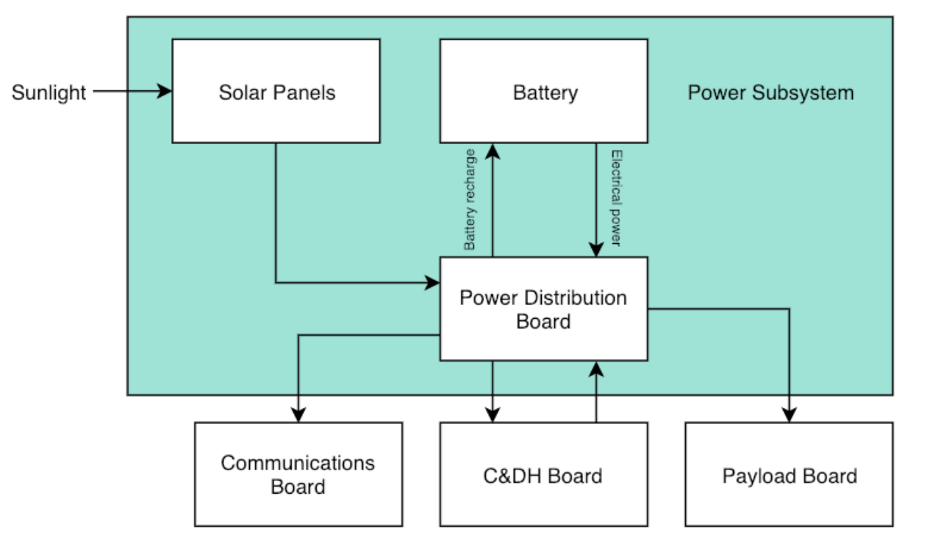
Mission and Vision
Power Subsystem Block Diagram
Notes:
Hari
Here is a block diagram representing the power subsystem breakdown.

Slide 7
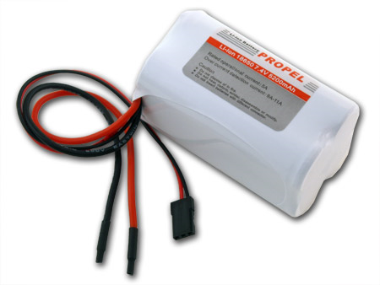
Changes Since CDR
Confirmed power requirements from other sub-teams
Investigated recharging via the solar panels
Researched failure modes for battery recharging at low temperatures
Notes:
Mac
With respect to the changes made since the CDR…

Slide 8
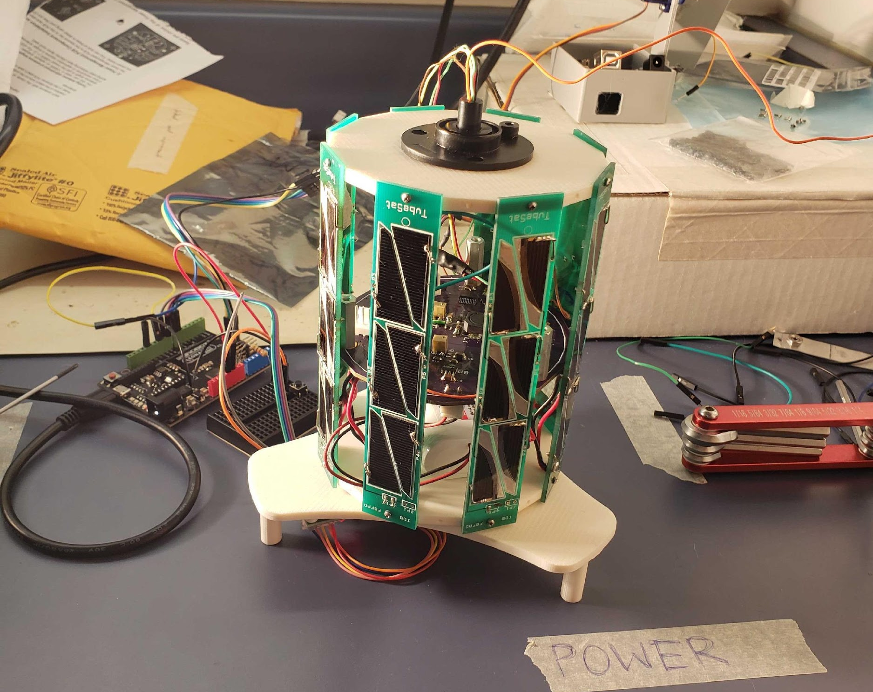
Changes Since CDR
Rotating platform assembly
Solar panel testing on rotating platform
Notes:
Mac

Slide 9
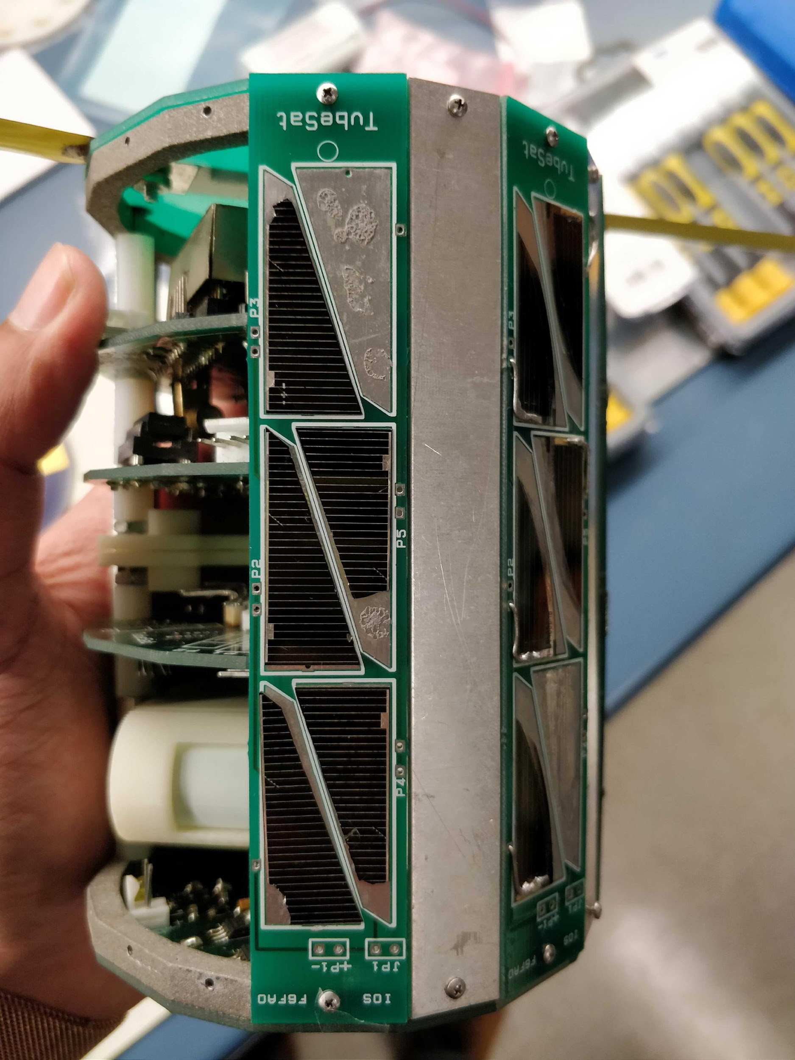

Design
The satellite power system has two operation modes:
Regular mode where solar energy is available
Sleep mode while in eclipse
Eight solar panels surrounding the hexadecagonal exterior
Arduino ecosystem used in conjunction with MATLAB
Notes:
Huraira
Hardware design as well as software design
The satellite power system has two operation modes, regular mode while solar energy is available and sleep mode while in eclipse. The C&DH system determines the current mode of the satellite and notifies the power system. If the system is operating in regular mode, the solar energy from the solar panels is converted into electrical energy to recharge the battery. During regular and sleep modes, the battery is used to provide power to the power distribution board. The PCB in turn provides power to the C&DH, Communication, and Payload boards.

Slide 10
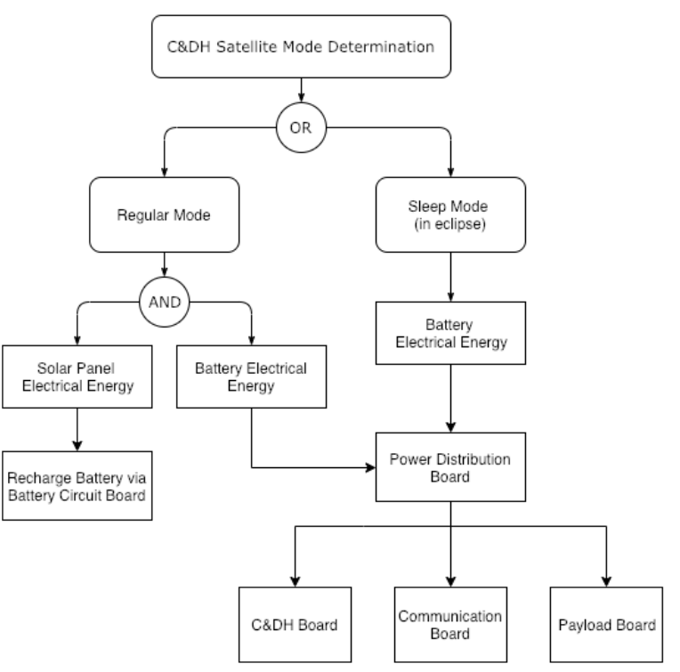
Design
Power Subsystem Functional Flow Diagram
Notes:
Huraira
Here is the functional flow diagram for the design of the power subsystem.

Slide 11
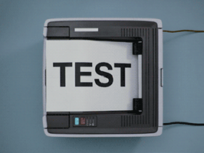
Assembly and Testing
Battery Discharge Test (Trial, @20°C, @-20°C)
Battery Vacuum Test
Battery Recharge Test
Individual Solar Panel PCB Test
Peak Power Closed Circuit Test
Solar Panel Vacuum Test
PCB Vacuum Test
Integration Test
Notes:
Gaja
These are all of the tests that were conducted/planned.

Slide 12
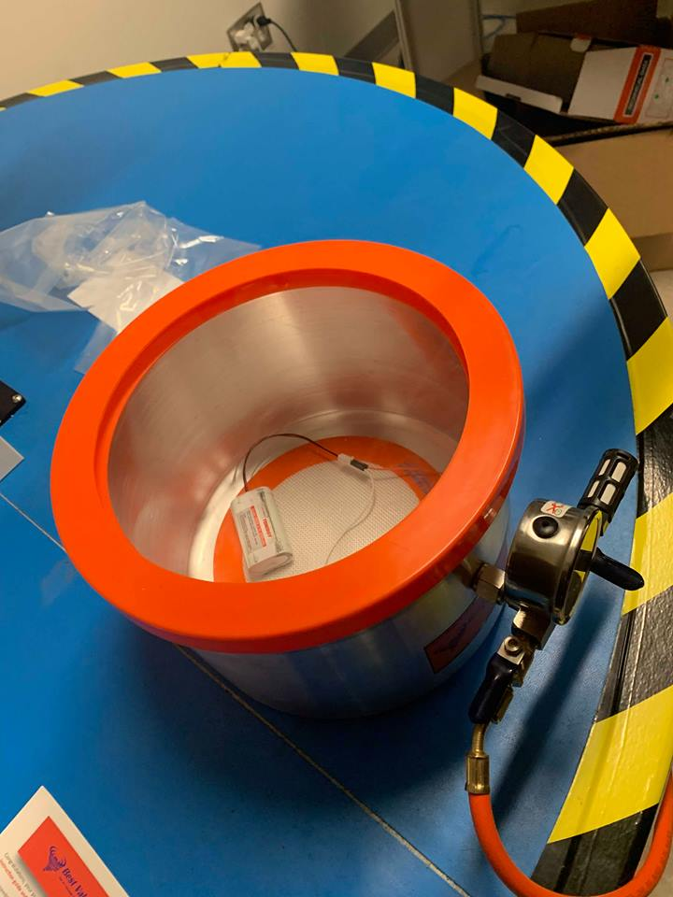
Assembly and Testing
Battery Test Apparatus
Tenergy Lithium-ion 3.7V 5200mAh battery
Tenergy battery charger
10-Ohm 5-Watt power resistor
Jumper wires
Vacuum chamber and vacuum pump
Freezer
Arduino Nano
Multimeter
Notes:
Gaja

Slide 13
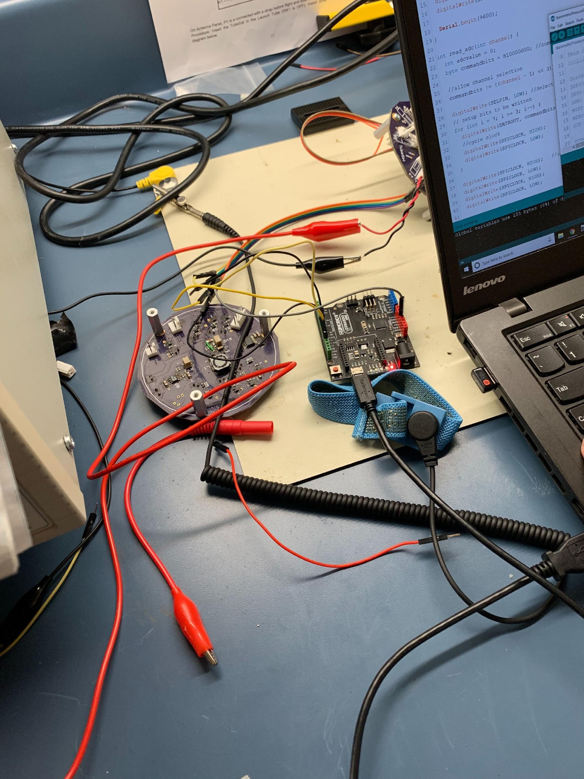
Assembly and Testing
Power Board Test Apparatus
PCB
Laptop with Arduino
Multimeter
Jumper wires
Vacuum chamber
Solar Panel apparatus
Notes:
Gaja

Slide 14
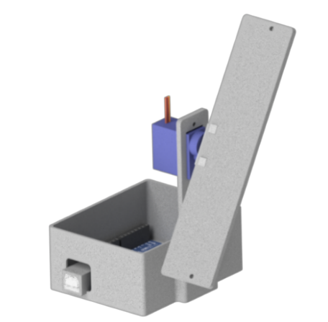
Assembly and Testing
Solar Panel Test Apparatus
Arduino Uno
Test apparatus
Servo Motor
Laptop with MATLAB software
Halogen Light Source
Multimeter
Jumper wires
Potentiometer
Solar Panel
Notes:
Gaja

Slide 15
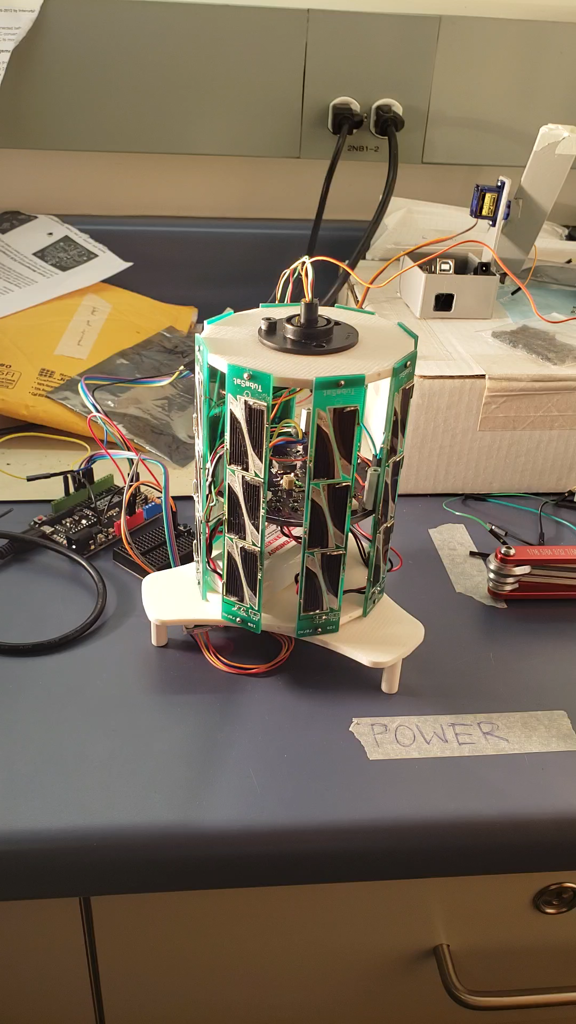
Assembly and Testing
Notes:
Nathan:
Rotating tube sat model
Slip ring to feed through SPI interface
Arduino to decode and relay data to MATLAB
Simulated light source ~65000 lux at a 5x bulb diameter distance from source

Slide 16
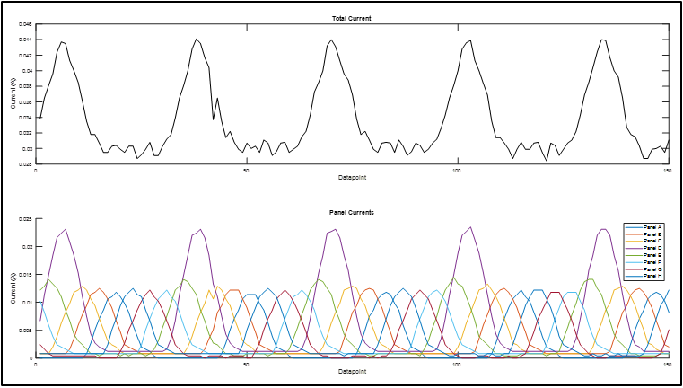
Assembly and Testing
Notes:
Nathan:
Anomaly due to different solar cells on one of the panels

Slide 17
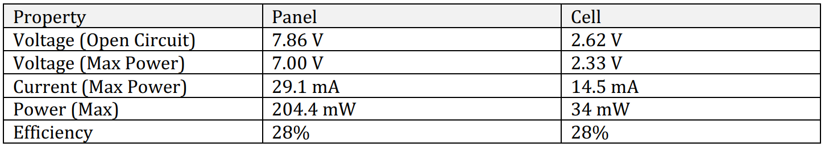
Test Results
Solar Panel Testing
Properties of Panel and TrisolX Wing
Notes:
Nathan
Preliminary tests were conducted on a solar panel with ID: Panel B. These results helped give insight to the characteristics of the solar panel with respect to incident light. As can be seen in Figure 6.1. Open Circuit Test Results for Panel B, it was found that the panel voltage steadily increased with incident angle until the 40deg mark at which point it began to plateau to about 4.7V. The open circuit current increased linearly with the incident angle. The testing was conducted at an illuminance of 14.5 mW/cm2 (roughly 100,000 lux) compared to the 136.6 mW/cm2 that would be seen in LEO. Due to this fact, the voltage and current outputs did not match the rated specifications, however it is assumed that the behaviour can still be used to characterize the panels

Slide 18
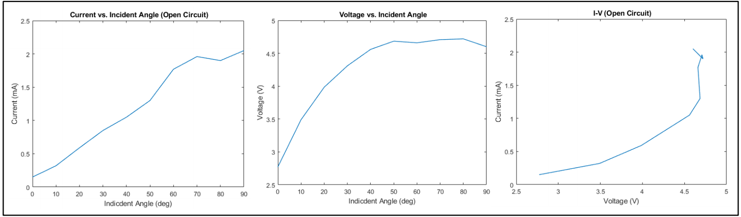
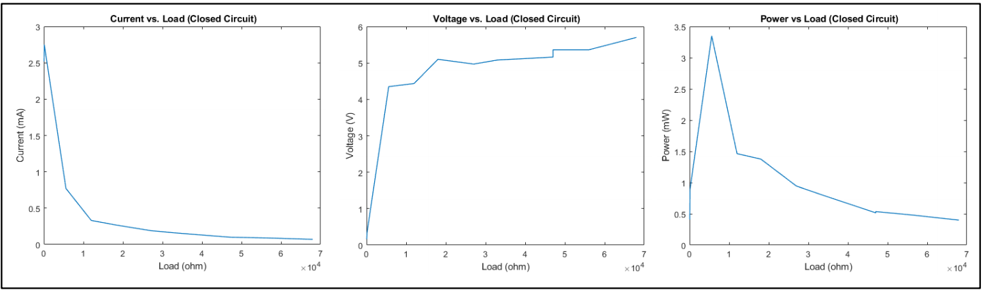
Test Results
Open Circuit Test Results for Panel B
Closed Circuit Test Results for Panel B
Notes:
Nathan
Testing was also conducted on the panels with a load in a closed-circuit configuration. The data showed that around 800ohms of load the panel was at its peak power output. Loads greater and less than this point showed large drops in power output. Additional testing was then conducted with more data points in the peak power range and with a more powerful light source. This showed the power output actually peaking at about 1200 ohms of load, but retained the same panel characteristics as was seen in the previous test.

Slide 19
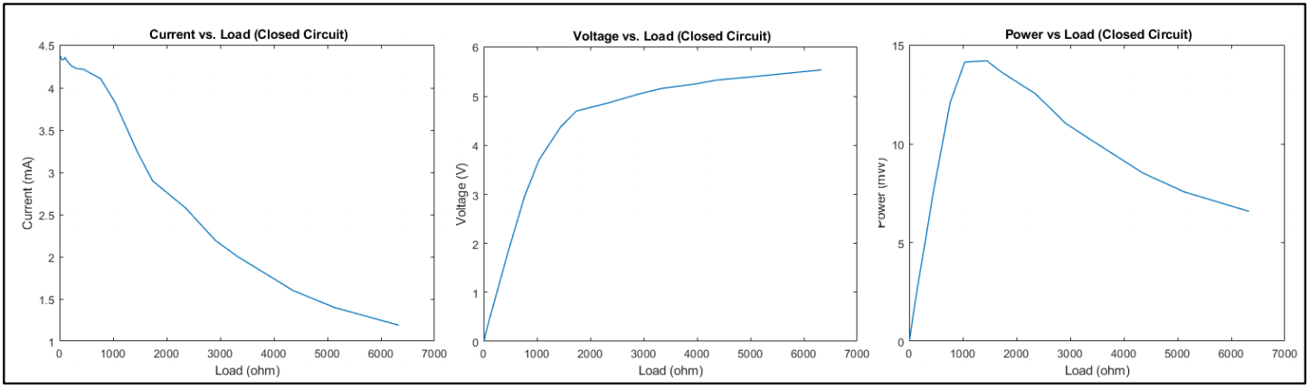
Test Results
Closed Circuit Testing Panel B (New Light Source, more data points)
Notes:
Nathan
At roughly 10% of the incident power of the sun used for our testing, a maximum power output if 14mW was achieved. Assuming a linear behaviour of the panel this would translate to 140mW which is about 68% of the maximum rated power output. Losses likely arose from numerous sources such as; incident angle, wavelength of light, point source approximation etc. A more powerful light source is desirable for final integration testing however the panel characteristics can still be approximated from the given data.

Slide 20
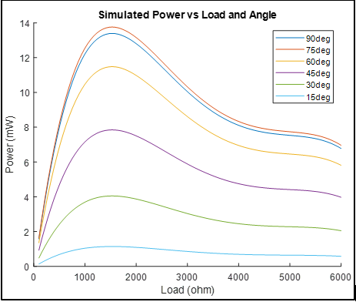
Test Results
Solar Panel Model Created in MATLAB
Notes:
Nathan
Panel model created from solar panel test data
Takes an input of load and angle and outputs the Voltage, Current and Power

Slide 21
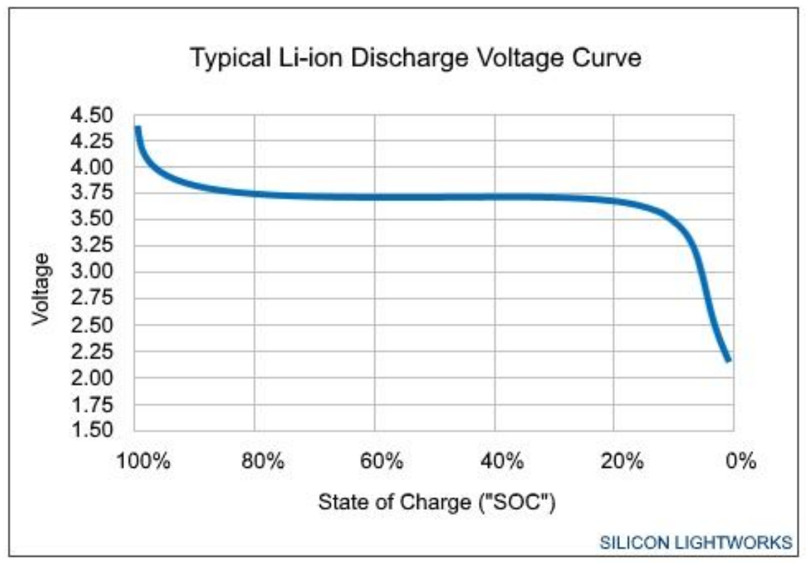
Test Results
Battery Discharge Testing
Typical Discharge Curve for Li-Ion battery
Notes:
Mac
To qualify the battery for space flight, it is important to understand its characteristics in different scenarios. To do so, the battery was subjected to discharge testing to monitor its voltage over time under predetermined loading. The setup had the battery connected to a set load (5-Watt, 10 Ohm power resistor) with an emergency cut-off switch in the event of a fault. The open circuit voltage levels were then monitored with an Arduino while the current and close circuit voltage were measured using a multimeter every hour over the course of the discharge cycle. The ambient discharge test was carried out at approximately 21°C. As shown by figure 6.4 and 6.5, the battery maintains a nominal discharging profile similar to typical Li-ion batteries. The current drain from the battery to the resistor is also very stable as shown in figure 6.6. Overall the discharging cycle last approximately 10 hours in total.

Slide 22
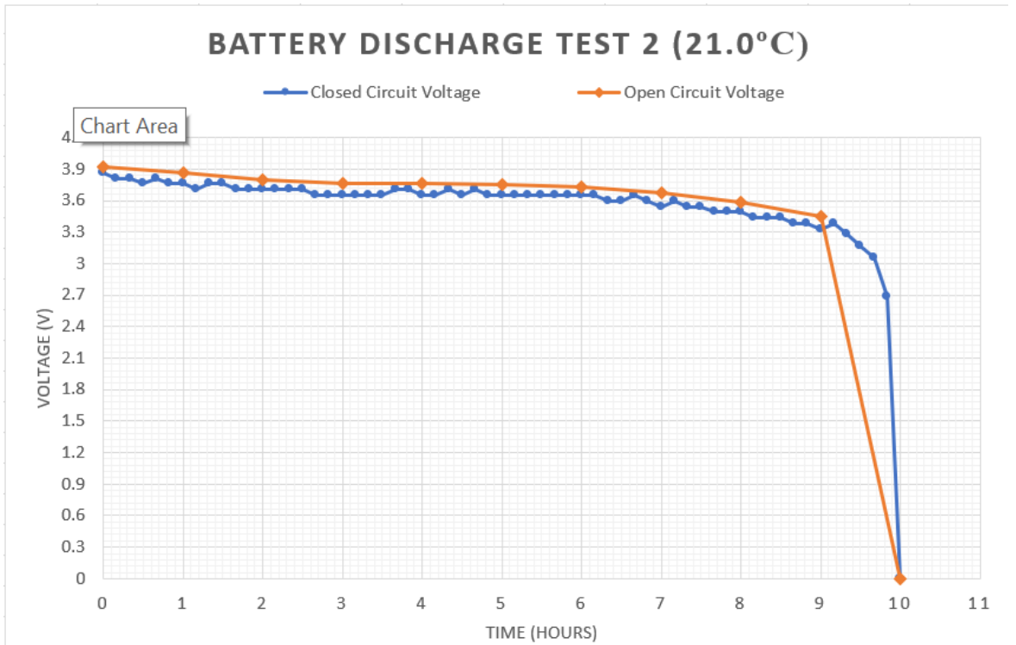
Test Results
Discharge Open and Closed-Circuit Voltage (20°C)
Notes:
Mac

Slide 23
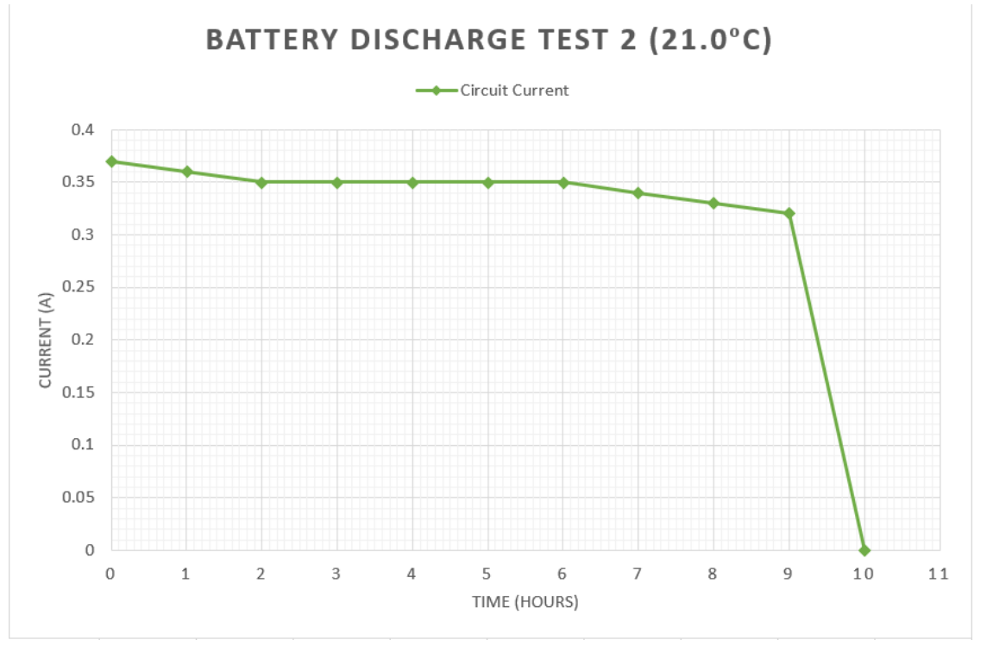
Test Results
Discharge Current (21°C)
Notes:
Mac

Slide 24
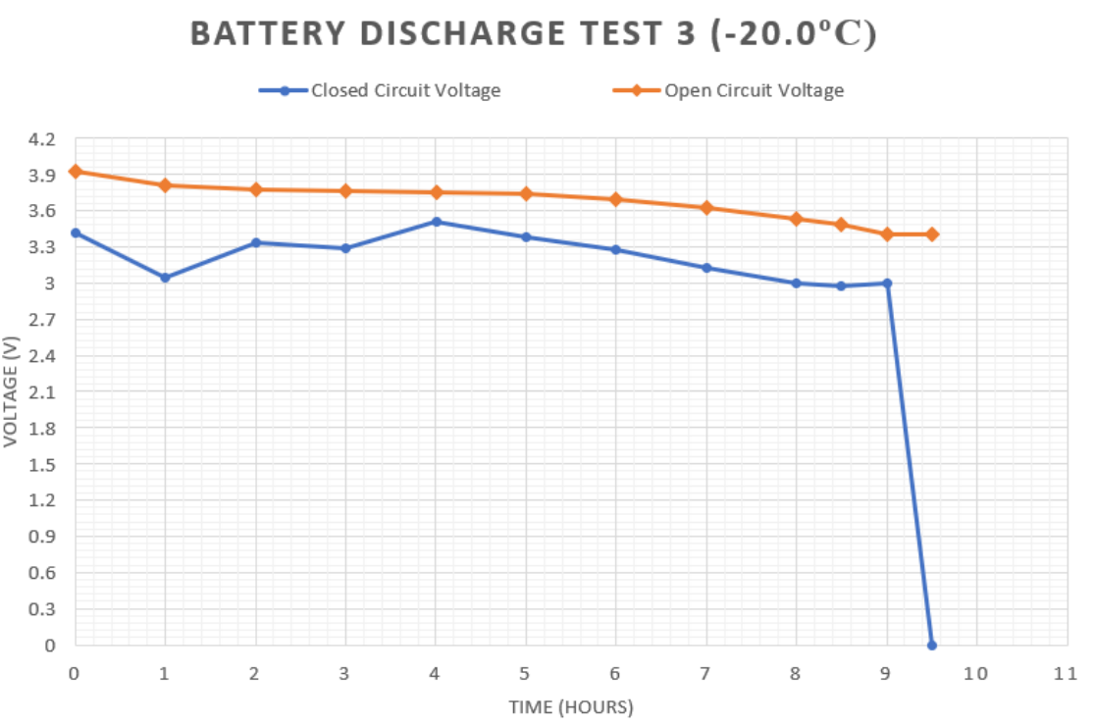
Test Results
Discharge Open and Closed-Circuit Voltage (-20°C)
Notes:
Alessio
A similar test was carried out at a temperature of -20°C using a freezer. Due to logistical problems, the Arduino wasn’t used to monitor the voltage of the battery every 10 minutes. Instead, the battery discharging apparatus was take momentarily out of the freezer to take readings for the voltages and current every hour.

Slide 25
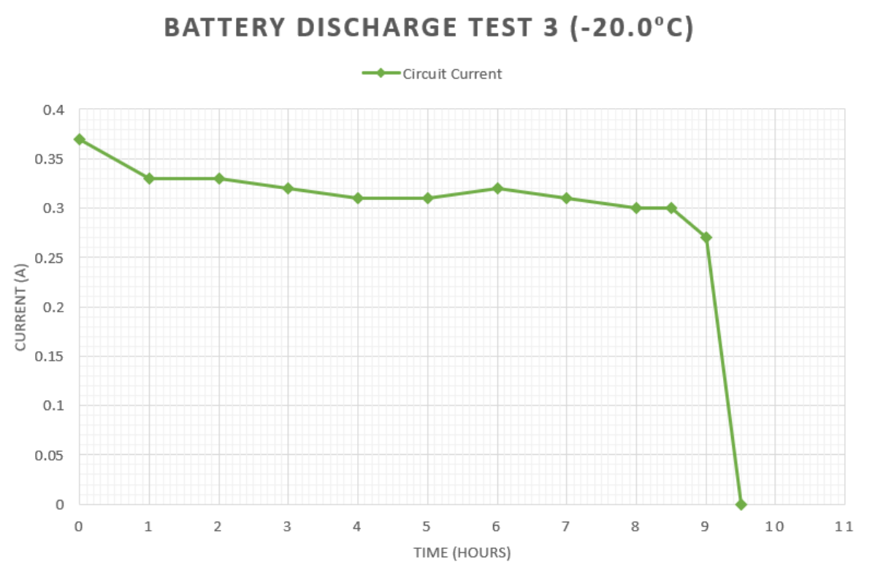
Test Results
Discharge Current (-20°C)
Notes:
Alessio
Looking at figure 6.7, one can notice that the open circuit voltage is consistent with the readings from the ambient test while the closed-circuit voltage fluctuates. This fluctuation can be due to the faulty connection between the battery and rest of the circuit. As one of the wires detached from the battery connector, the wire had to be attached to another jumper wire using electrical tape. This make shift connection could have seriously affected these voltage results especially when considering the motions occurring every time the readings were taken via the multimeter. Overall, the battery duration and the current (as shown in figure 6.8) are consistent with the results taken from the ambient discharge test, making this test also a success.

Slide 26
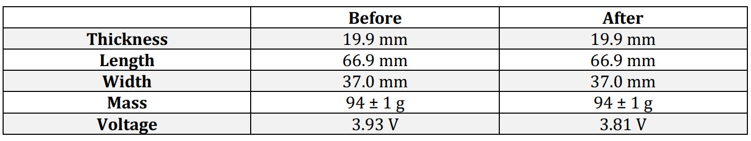
Test Results
Vacuum Test Results
Notes:
Alessio
A partial discharge test was also carried out using a vacuum chamber to mimic the harsh space environment. The battery was placed charged at a voltage of 3.93 V inside the chamber along with the discharging apparatus. Once the chamber was sealed the pump brought the pressure to approximately -0.98 bar. The battery was kept discharging in the chamber from 2 hours. Table 11 shows the data recorded before and after the test. The physical properties of the battery remained unchanged and the voltage drop from 3.93 V to 3.81 V is consistent with a normal 2-hour discharge in ambient pressure. These results show that the battery is indeed capable of functioning in a vacuum environment.

Slide 27
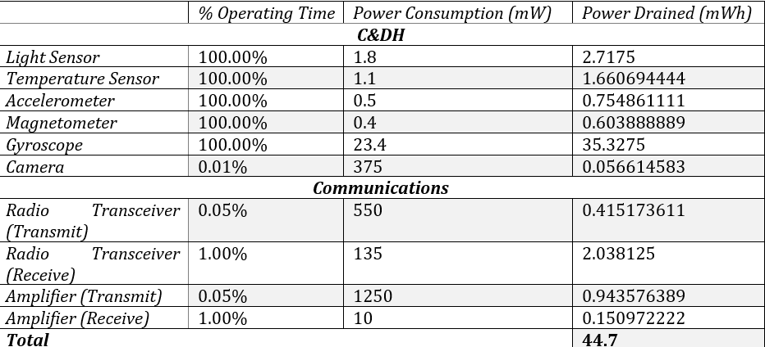
Test Results
RyeTubeSat: Power Budget
Notes:
Nathan
Finite power generation
Mission needs need to take that into consideration when using heavy draw components

Slide 28
Remarks
Research possibility of improved battery
Expand power budget to include solidified details
Investigate further into simulation
Prepare integration testing with more urgency
Notes:
Huraira
In terms of future considerations, investing in a space-rated battery with a higher capacity could be an option for expansion of the power subsystem’s scope.
Also, solidifying the details of the power budget by confirming the specifications with each team could be an area for improvement.
Simulation using STK or a multitude of other software could also help with respect to the data needed to ensure optimal performance of the power system.
A stricter approach in terms of time management and testing could be applied to better prepare the team for integration testing.

Slide 29
Thank You !
Questions ?

Slide 30
References
[1] Ryerson Aerospace Class of 2018, "Payload, Power, Structures Preliminary Design Review," Ryerson University, Department of Aerospace Engineering, Toronto, 2018.
[2] 2017, Ryerson Aerospace Class of, "Rye TubeSat FRR," Ryerson University, Department of Aerospace Engineering, Toronto, 2017.
[3] 2018, Ryerson Aerospace Class of, "Rye TubeSat FRR," Ryerson University, Department of Aerospace Engineering, Toronto, 2018.
[4] S. Lightworks, "Li-ion Voltage Analysis," [Online]. Available: https://siliconlightworks.com/liion-voltage. [Accessed 2019].

